Slide 1
Classify Report
Made by Leyan

Slide 2
Outline
DataSet
Preprocessing
Decision Tree
Evaluation
Discuss

Slide 3
DataSet
Description
Create a car accidient data contain 10 Features
Which involves of Sex , Occur time , Experience , Drink wine ,
Environment , Road Status , Car size , Income , Use phone , Age

Slide 4
DataSet
Features (K=10) :
Sex : {man,woman} 駕駛人性別
Occur time : {light,night} 車禍發生時間
Experience : {0~31} 駕車經驗
Drink wine : {Y,N} 是否有喝酒
Environment : {quiet,noise} 車內環境
Road Status : {safe,dangerous} 路況
Car size : {big,small.medium} 車輛大小
Income : {30~100} 收入(K - USD)
Use phone : {Y/N} 使用手機
Age : {18~70} 年齡

Slide 5
DataSet
Generate Rule
(Drink(Y) & Enviorment(noise)) |
(Road Status(Dangerous) & Use-phone(Y)) => Accidient
Label
Accicident : (Y / N )

Slide 6
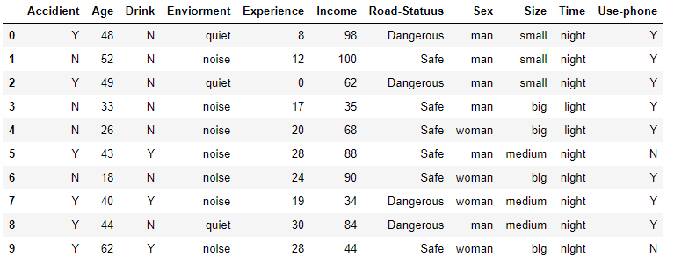
DataSet
M = number of data = 1000
df = generate_data(M)
Data Frame from index [0:10]

Slide 7
Preprocessing
Data Mapping

Slide 8
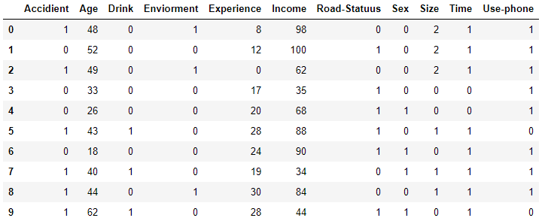
Preprocessing
Data Mapping (Text to Number)

Slide 9
Decision Tree
criterion->表示在基於特徵劃分數據集合時，選擇特徵的標準。默認是'gini‘
splitter->表示在構造樹時，選擇特徵點分類的原則，默認是splitter='best‘
max_features->這個參數表示在劃分數據集時考慮的最多的特徵值數量
max_depth : 樹的最大深度
min_samples_split : 分解內部結點時最少的樣本數
min_samples_leaf : 每個葉節點最小的樣本數目
min_weight_fraction_leaf : 樣本之間的權重
max_leaf_nodes : 最優分類中考慮的葉節點數
class_weight : 每個分類的權重
random_state : 賦予決策樹隨機性
min_impurity_split : 葉節點分裂閾值，僅僅當他的impurity超過閾值時才會繼續向下分解，否則會成為葉節點
Presort : 擬合前，是否預分數據來加快樹的構建

Slide 10
Decision Tree
DecisionTreeClassifier(class_weight=None, criterion='entropy', max_depth=None,
max_features=4, max_leaf_nodes=5,
min_impurity_split=1e-07, min_samples_leaf=1,
min_samples_split=4, min_weight_fraction_leaf=0.0,
presort=False, random_state=None, splitter='best')

Slide 11
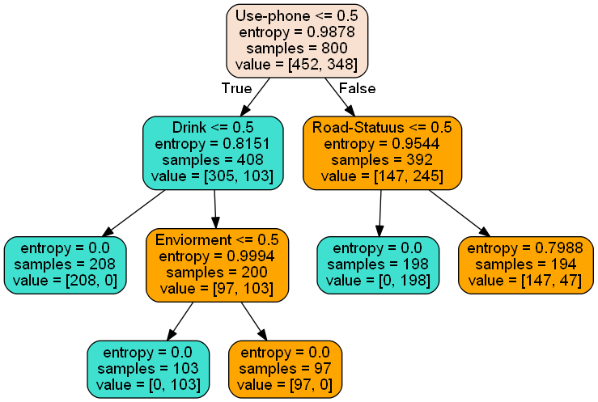
Decision Tree
(Drink(Y) & Enviorment(noise)) |
(Road Status(Dangerous) & Use-phone(Y)) => Accidient
Drink
Compare Rules :
Y(1)
N(0)
Enviorment
Road Status
Dangerous(1)
Safe(0)
Noise(1)
quiet(0)
Use-phone
False
True
False
Y(1)
N(0)
True
False

Slide 12
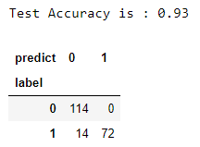
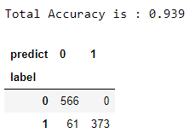
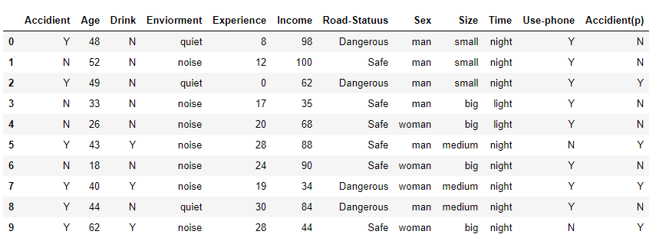
Evaluation
Accurate :
Use confuse matrix

Slide 13
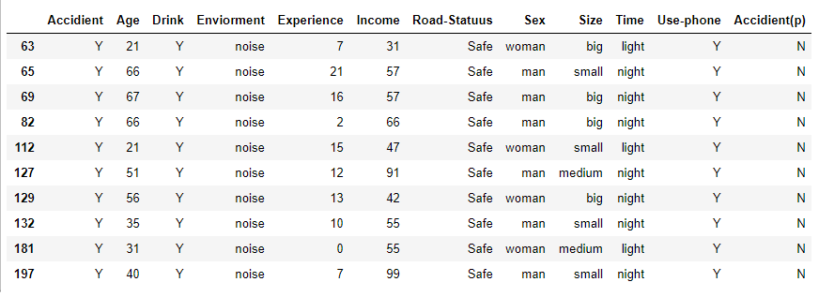
Discuss
We can do preprocessing with normalization ex: StandardScaler, MinMaxScaler, RobustScaler
We can use predict fail data to do next classifier (前10筆為例)

